Slide 1

Marvel Search Page
John Raab, Jay Barnaba, and Preston Vongvilay

Slide 2
Search your favorite Marvel character to display their history.

Slide 3
Concept
Description:
The page will pull from Marvel and Wikipedia to display the description of the character, their image, and character history on the page.
Motivation for Development?
We are Marvel fans who wanted to create a page that would display character information in a single search, without having to visit multiple webpages.
User Story:
As fans of the Marvel universe, our team wanted to create a fan page where visitors could search their favorite character to retrieve their history, including movies, comics, series, and more.

Slide 4
Process
Technologies Used:
Webpage style: Bulma documentation.
Referenced Marvel API webpage for help with API.
Stackoverflow, W3 Schools, Code Academy, YouTube videos on API, and femkreations GitHub for Wikipedia API search function.
Breakdown of Tasks and Roles:
Preston: Main source of CSS and HTML, also worked on the Marvel API to display images.
John: Worked on the Wikipedia API, JS, Readme file, display results, images, and created PowerPoint presentation.
Jay: Worked on the Marvel API, JS, and code running.

Slide 5
Process
Challenges:
Many challenges getting the API from Marvel and Wikipedia to display on the page and get the correct results. Styling with Bulma, instead of bootstrap.
Successes:
We were able to fix all our issues and got the page to display the correct information, along with styling the page into the way we wanted it to look.

Slide 6

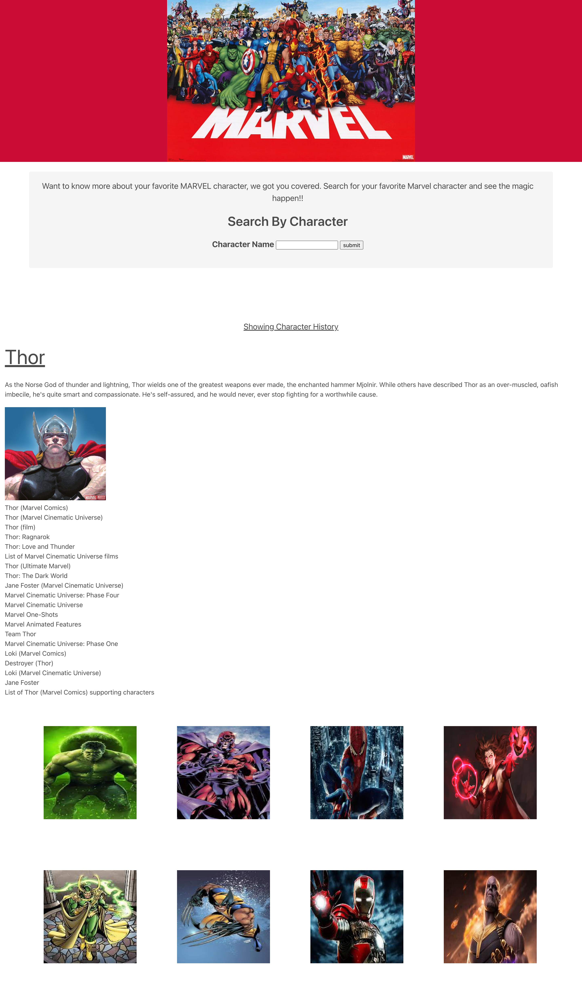



Demo

Slide 7
Directions for Future Development
If we had more time…
Live ”clickable” result links.
Search results separated by movies, comics, series, etc.
An image carousel to scroll along the page for effect.

Slide 8
Links
Deployed: https://pvongvilay.github.io/marvel-search/
GitHub repo: https://github.com/pvongvilay/marvel-search

